Slide 1
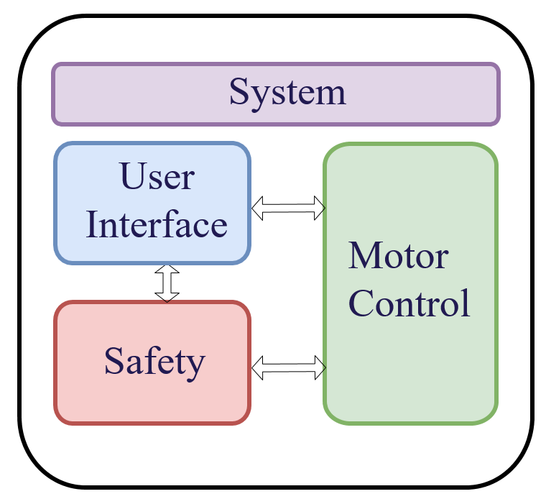
Motor control
Slide
of 59
Position estimation
Analog signal acquisition
Closed loop algorithm
Nicolai

Slide 2
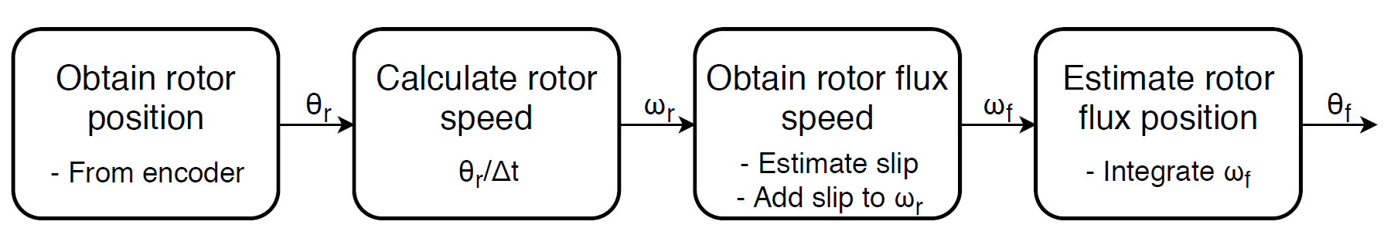
Position estimation
Slide
of 59
Nicolai
Notes:
Calculate position from amount of pulses received
Calculate speed from the position change every 30 electrical degrees or within a specified time period (If speed is slow)
Slip speed is estimated from Machine parameters and dq-current references
Rotor flux speed is found by adding the shaft speed and the slip speed.
Integrated to optain estimated flux position, used for reference frame transformations

Slide 3
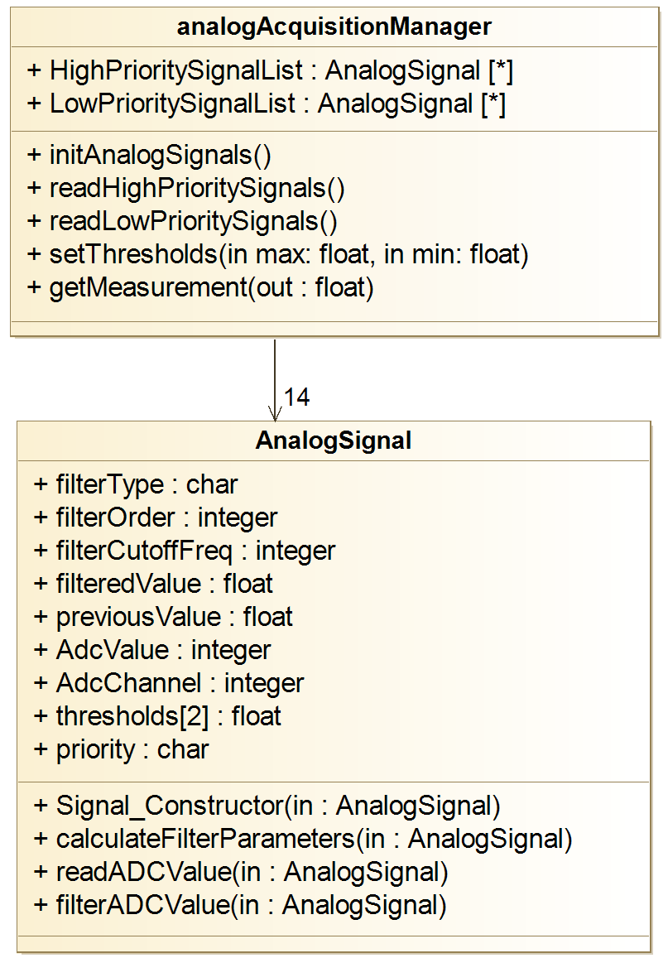
Analog signal acquisition
Slide
of 59
Analog signal structure
Raw ADC value
Filtered value
Previous value
Filter order
Filter frequency
Filter parameters
ADC channel
Priority
Safety thresholds
Interface functions
Nicolai

Slide 4
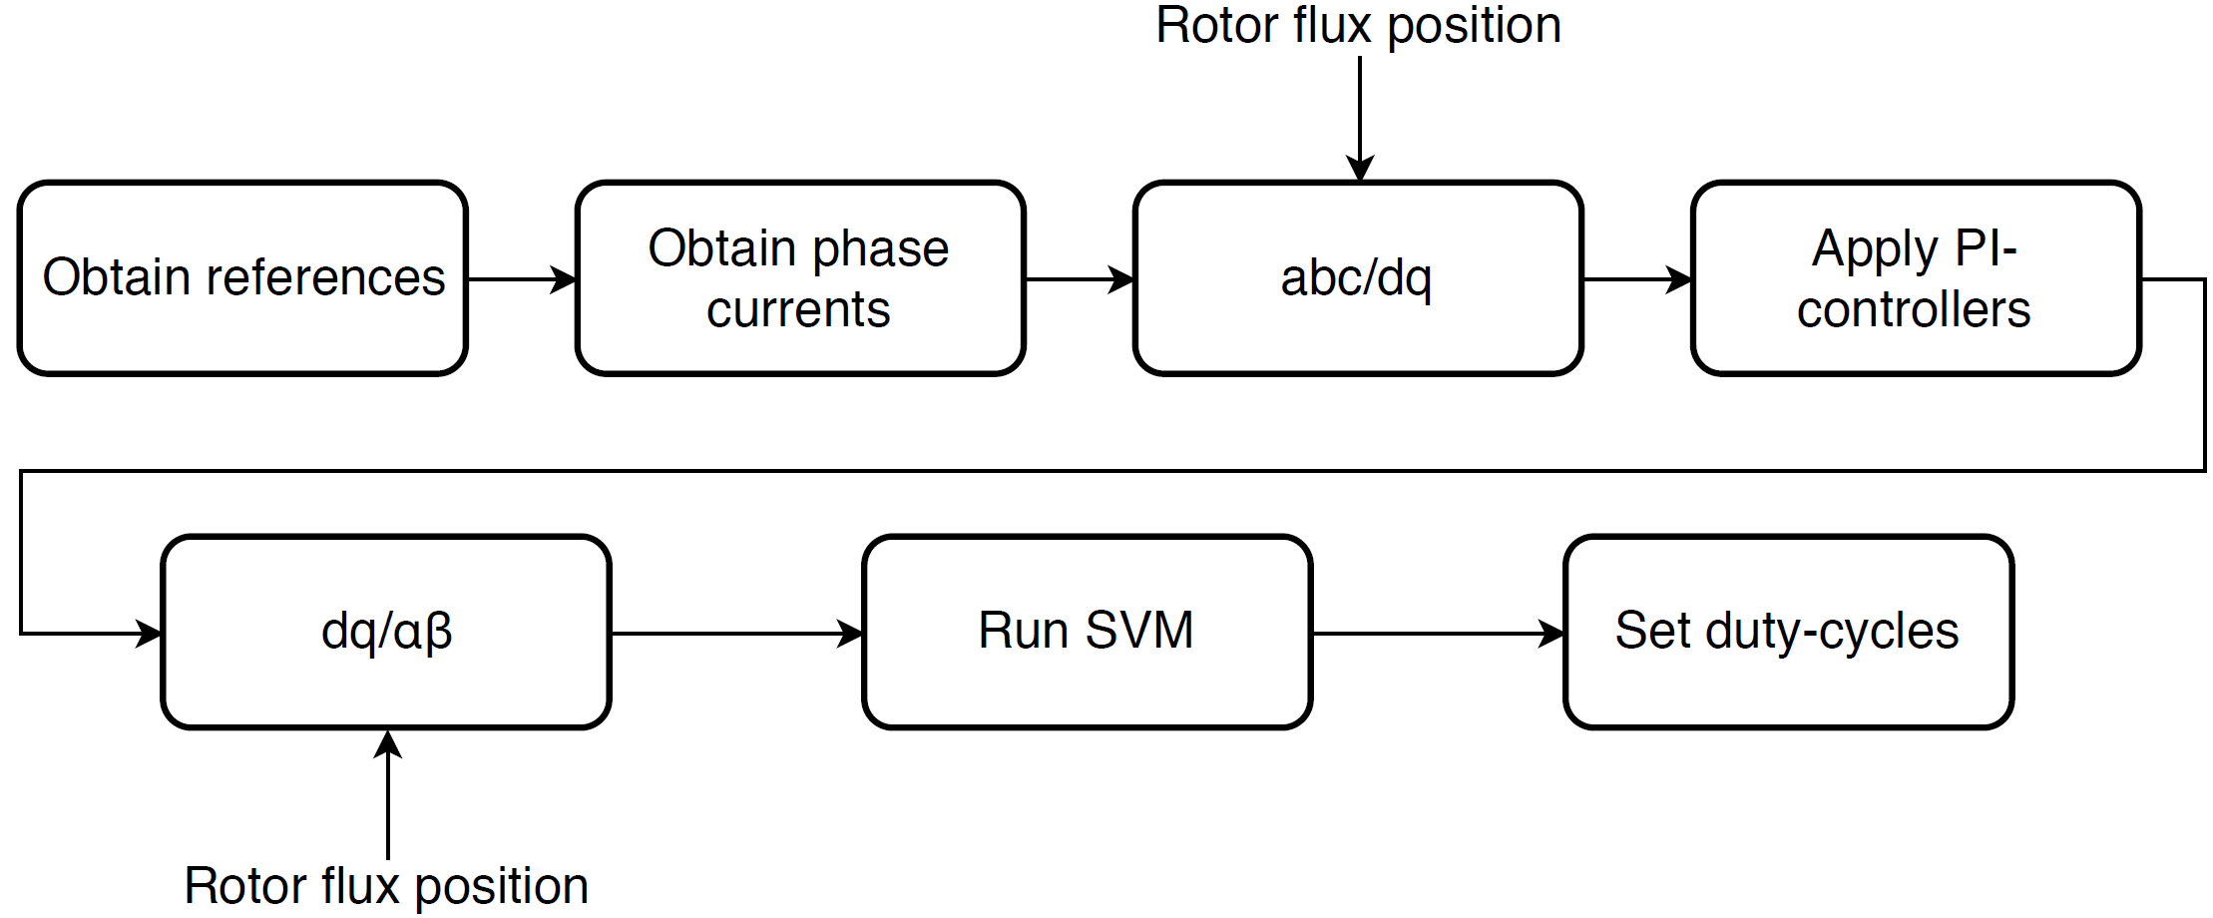
Closed loop control algorithm
Slide
of 59
Nicolai

Slide 5
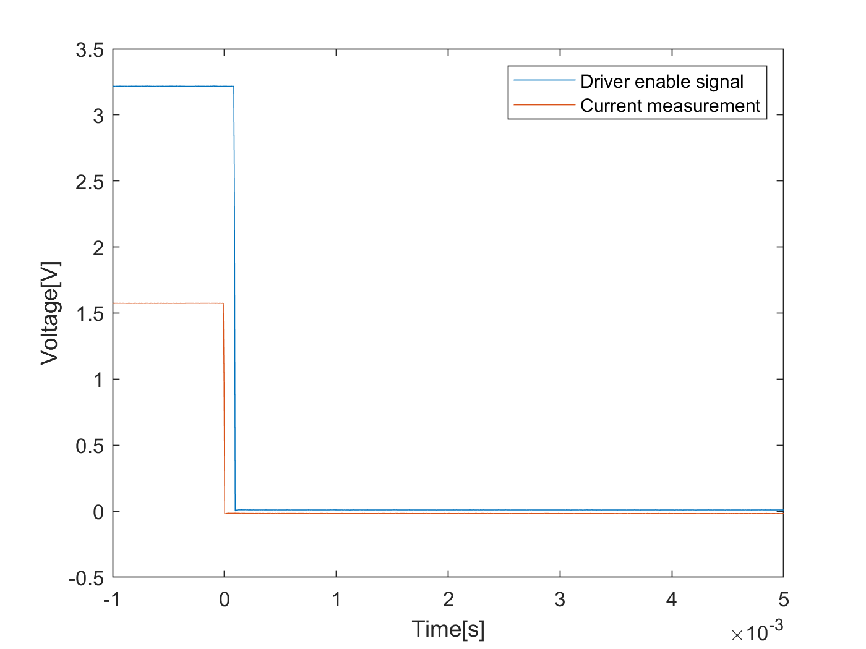
Safety
Slide
of 59
Monitors possible error sources
Overvoltage
Overcurrent
Temperatures
Performs the necessary safety reaction
Includes a watchdog timer
Nicolai

Slide 6
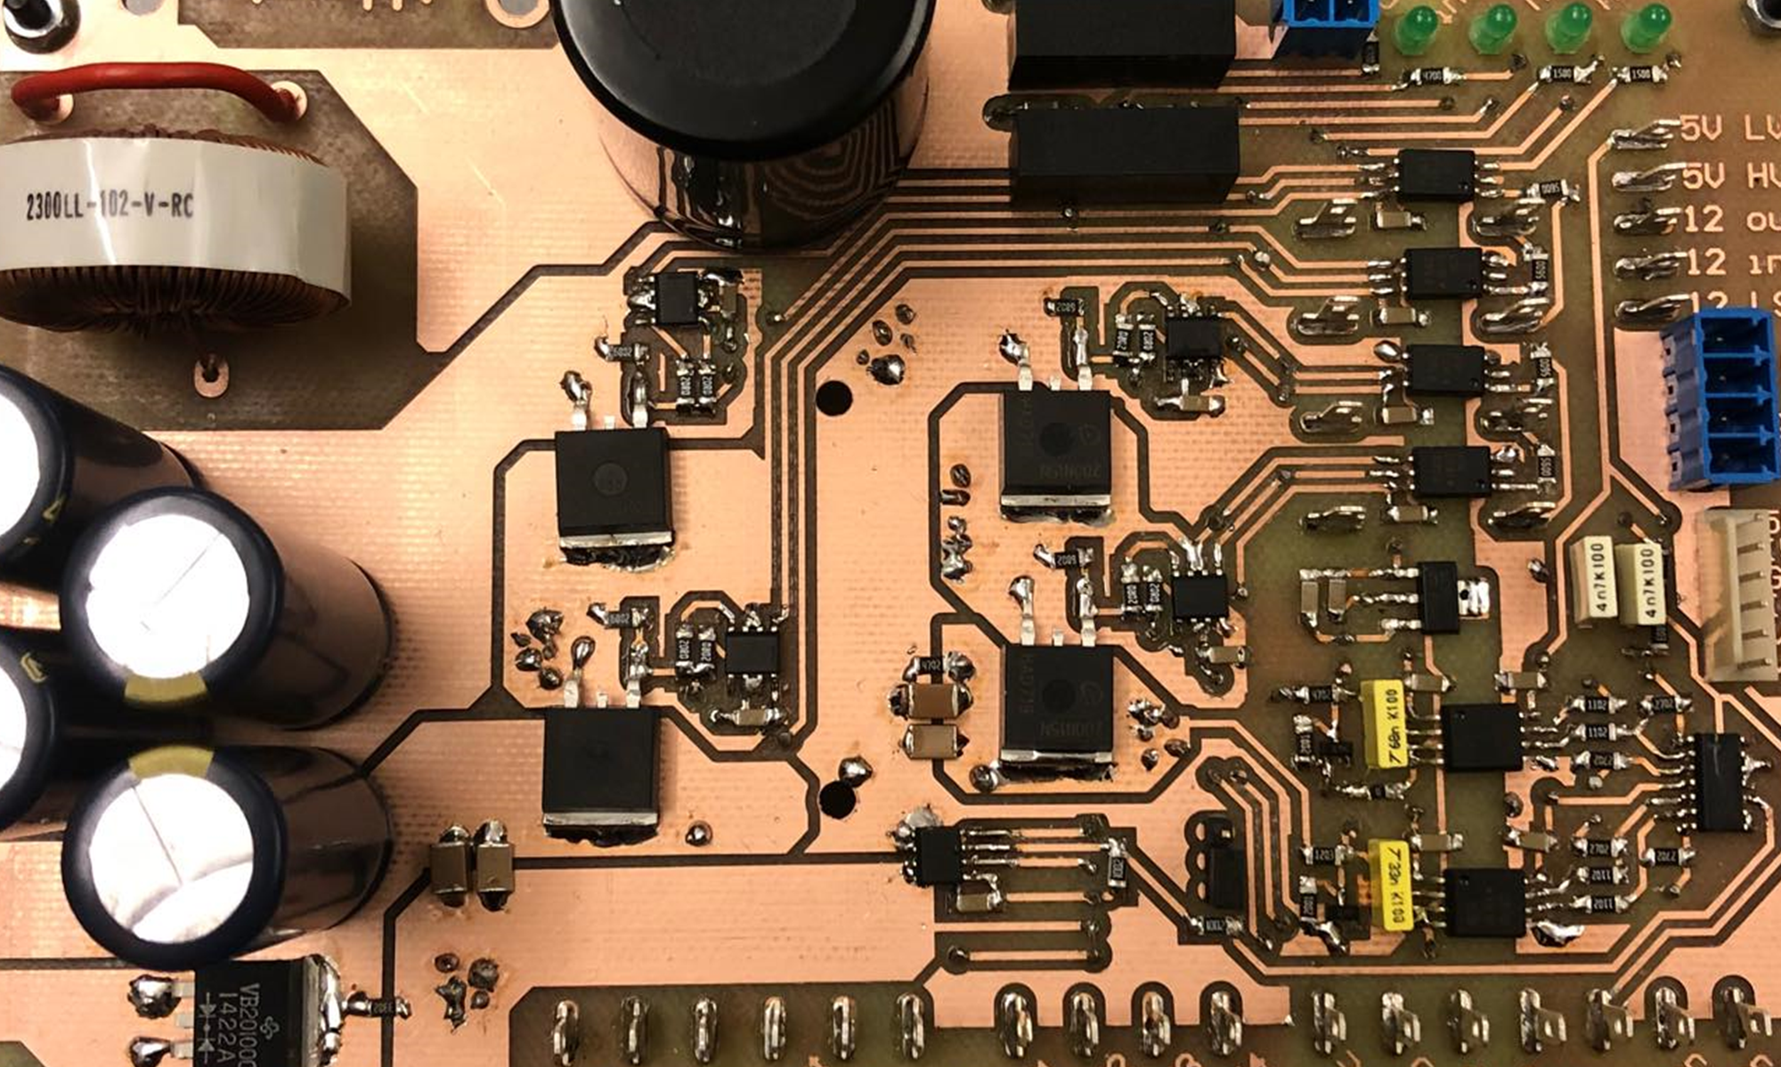
System tests

Slide 7
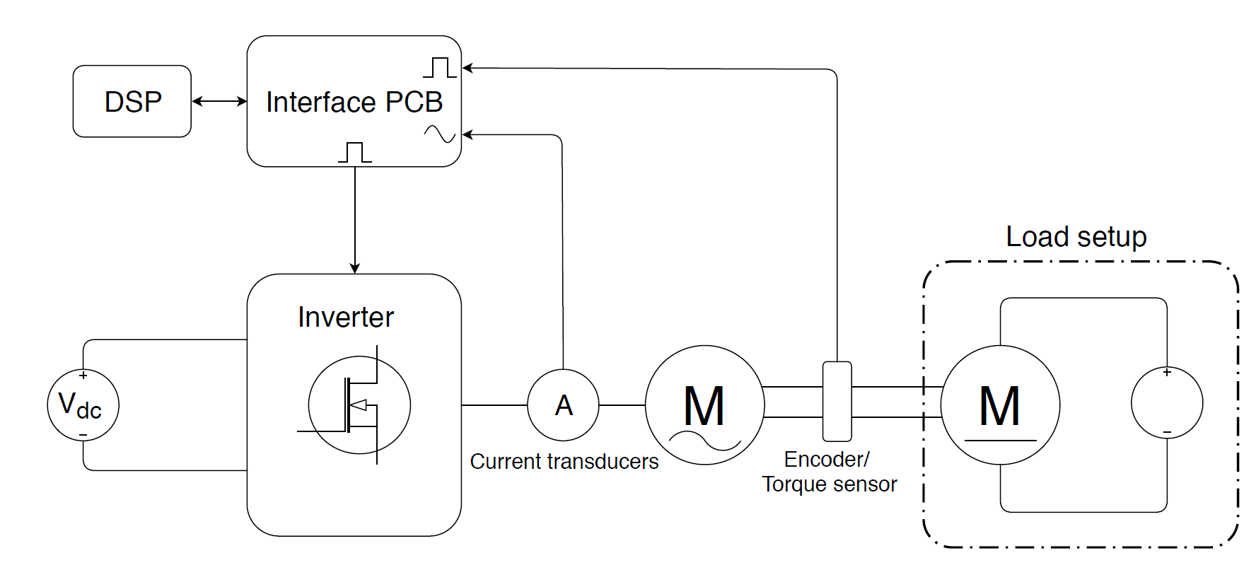
Test setup
Slide
of 59
Nicolai

